Slide 1
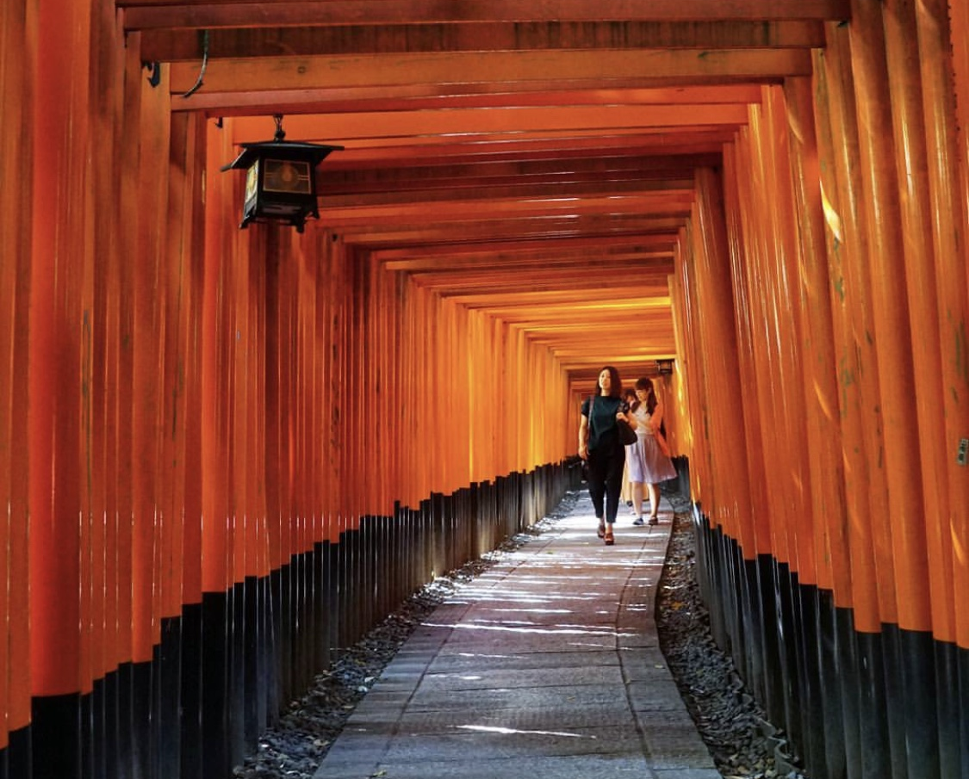
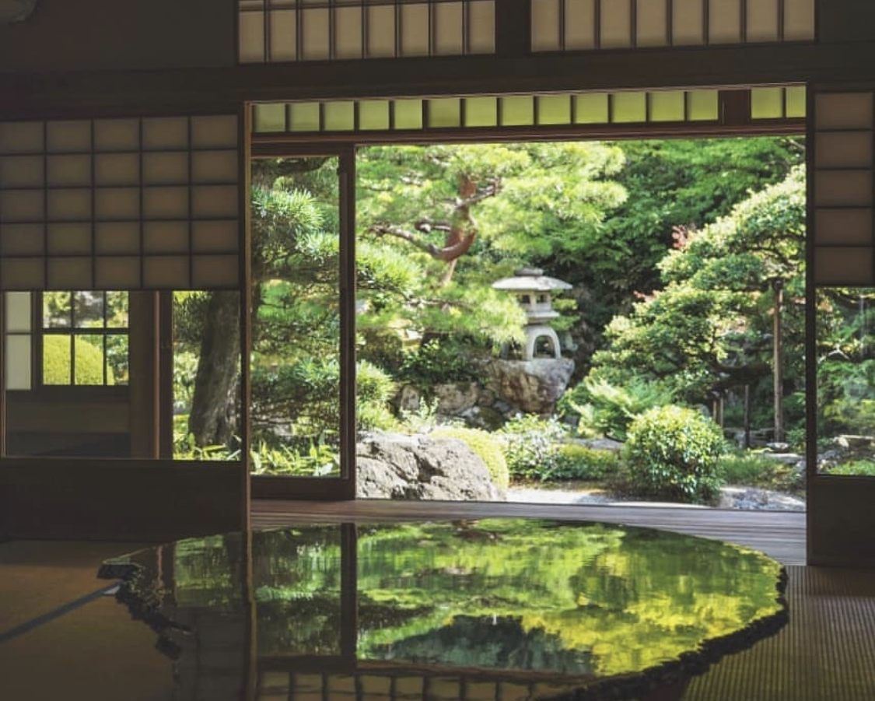
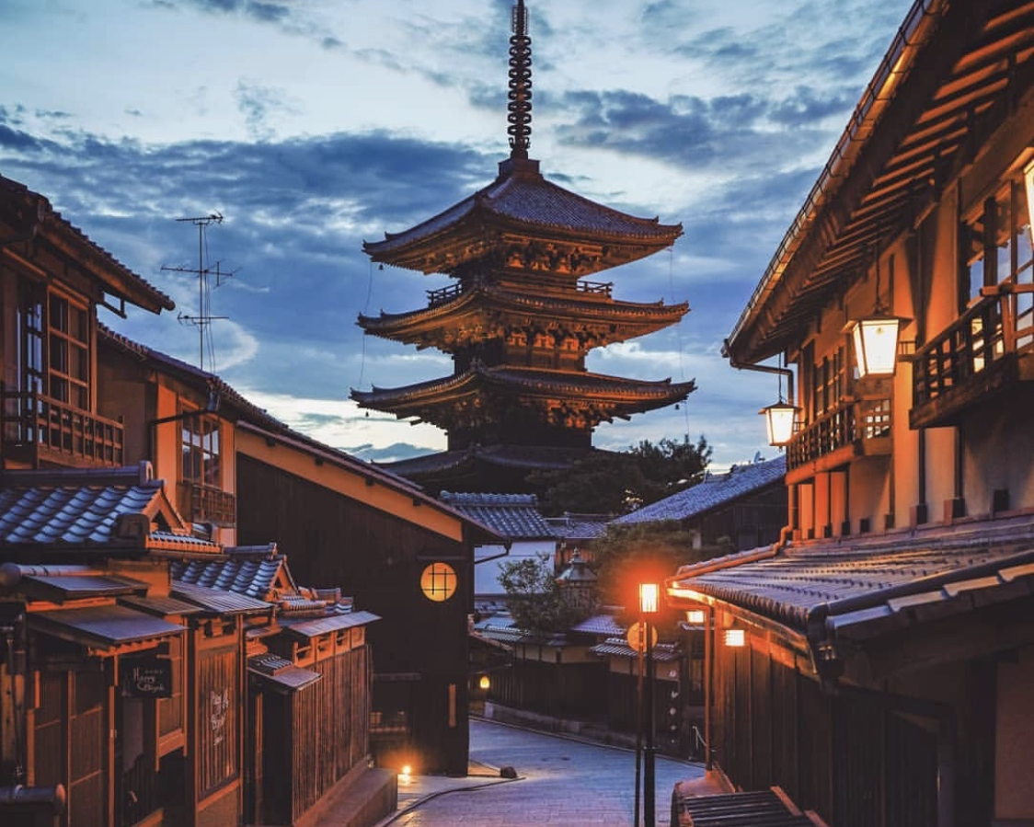
The Battle of Neighborhoods
How to choose the best hotel in Kyoto and nearby areas?
Klaire Zhou
May 2020

Slide 2
I. Business Problem Section
Kyoto, once the capital of Japan, is in the island of Honshu. Millions of travelers visit Kyoto each year to explore the city's cultural and historical attractions.
Things to consider before travel: right location, accommodation, flights, rental cars to attractions, restaurants, stores and other facilities.
In this scenario, the business problems I am trying to solve:
I. How to help different stakeholders (visitors or tourism agencies) in choosing the best accommodation?
II. Which places are the best for them to stay?

Slide 3
II. Data Section
To perform this idea, I utilized data from 2 different sources:
1. Data from: https://www.booking.com: information about postal code, name, address of 40 hotels.
2. Foursquare location data: for data exploration, visualization and modeling.
1+2 = The final database:
develop the machine learning models and to cluster Kyoto nearby areas neighborhoods.

Slide 4
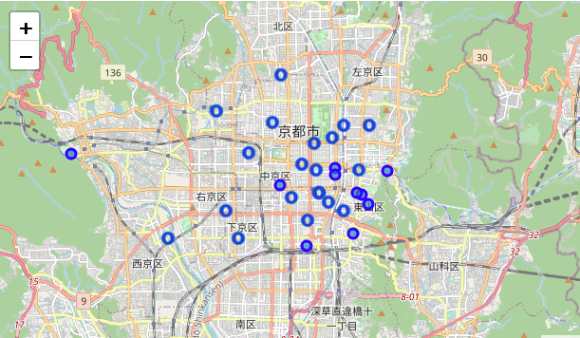
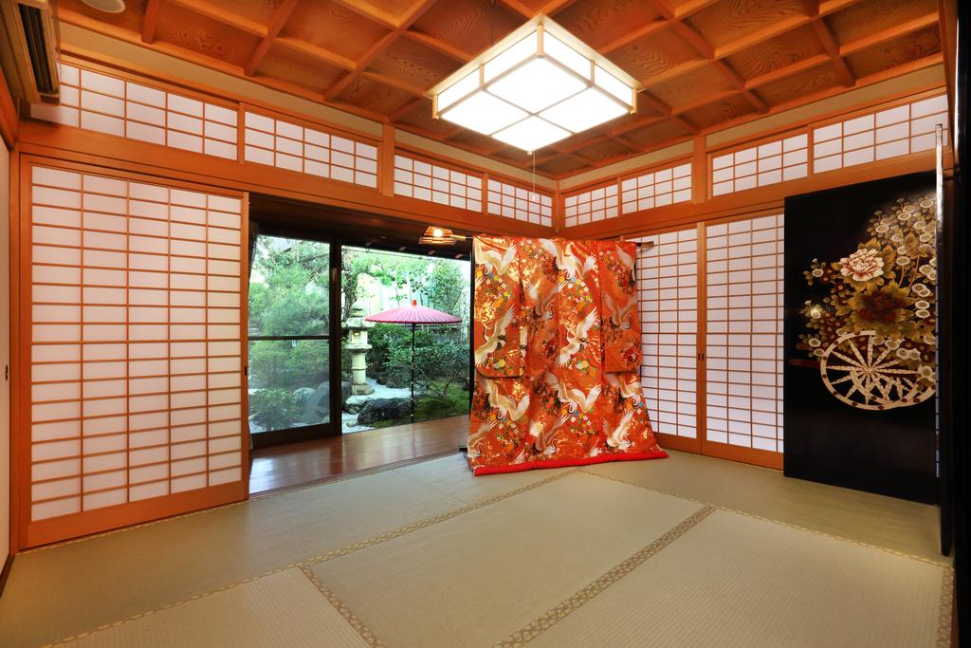
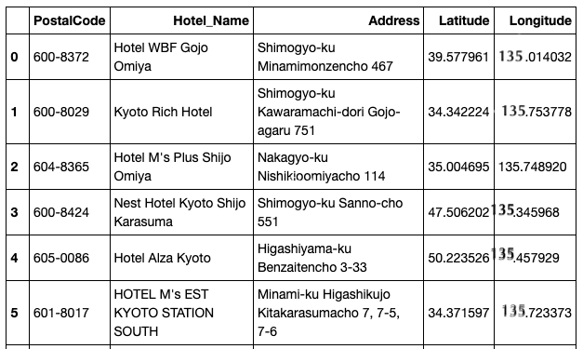
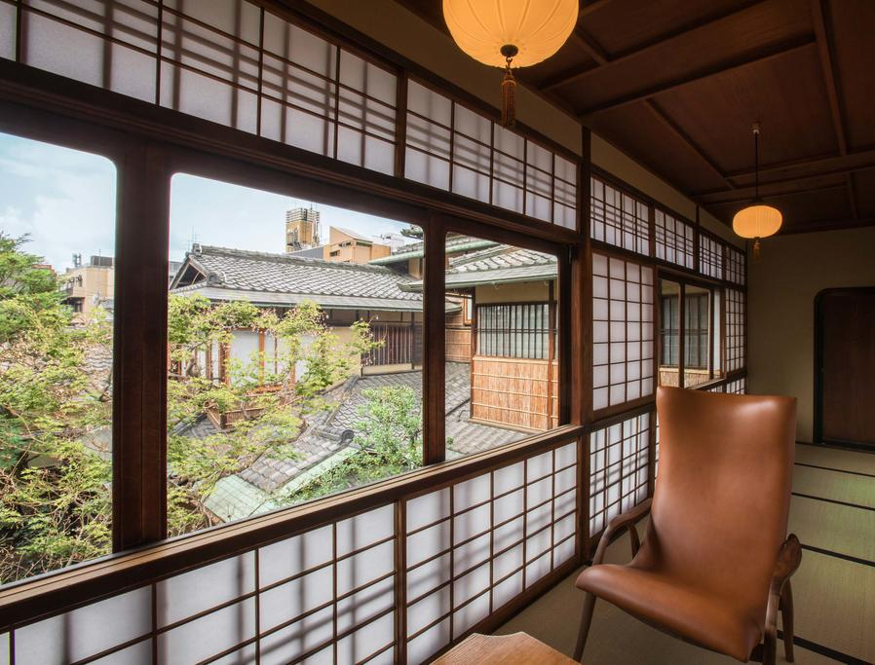

Slide 5
III. Methodology section
3-steps process:
1. Data Collection
2. Data Understanding and Exploration
3. Data Modeling: K-means Clustering

Slide 6
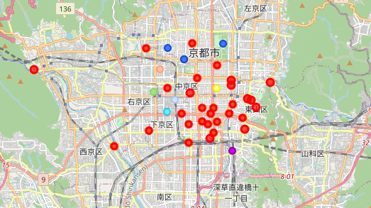
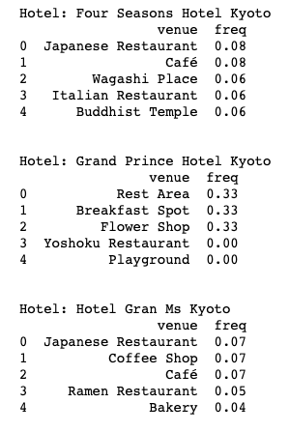
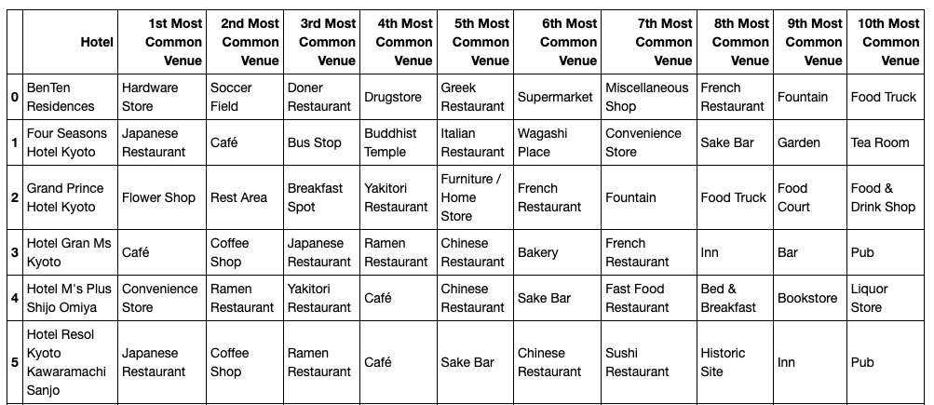
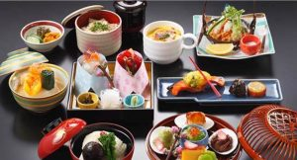

Slide 7
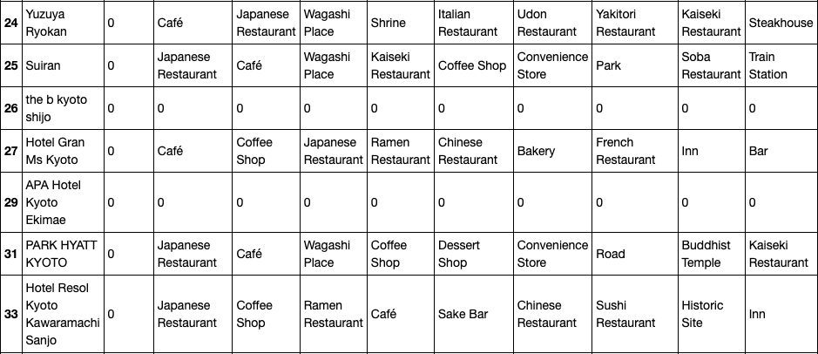
The 1st Cluster

Slide 8
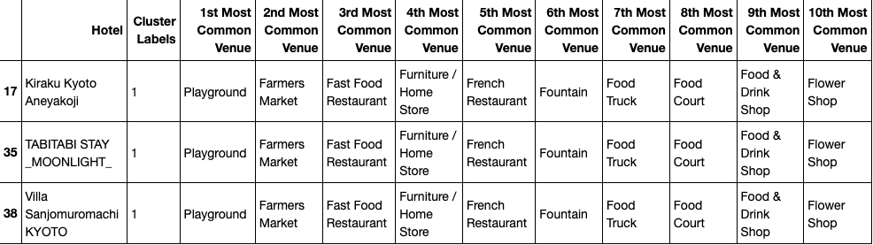
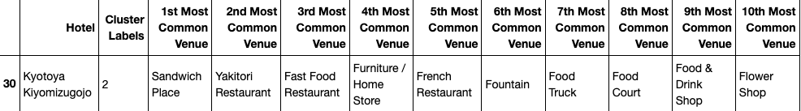
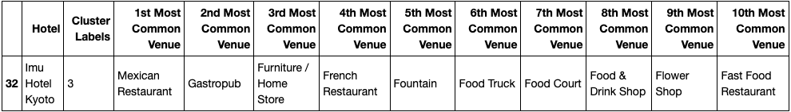
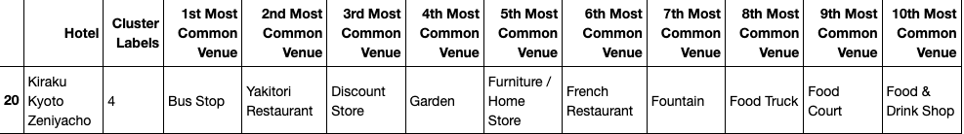
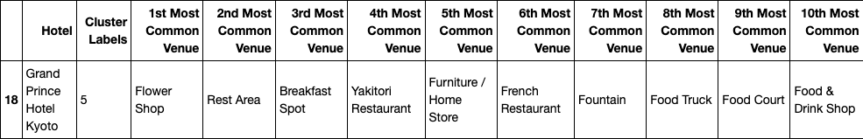
The 2nd Cluster
The 3rd Cluster
The 4th Cluster
The 5th Cluster
The 6th Cluster

Slide 9
IV. Results Section
1. Hotels close to center of ward and tourist attractions have the most facilities: Hotel Gran Ms Kyoto, Hotel Resol Kyoto Kawaramachi Sanjo, The Thousand Kyoto… compared to hotels located further from center of ward and tourist attractions: Kiraku Kyoto Aneyakoji, Grand Prince Hotel Kyoto, Imu Hotel Kyoto…
2. wide range of restaurants (Yoshoku, American, Chinese, Donburi, Dim Sum.etc), Art museum, Antique Shop, Beer bar, Camera store, Flower shop, Ice Cream Shop, Grocery stores, Train station… close to each hotel
3. Hotels from central areas have particular facilities, such as: local and foreign restaurants, cafe, bar, bakery, grocery stores along with tourist attractions: Nineizaka (Ninenzaka), Hōkan-ji Temple, The Museum of Kyoto, Higashiyama Jisho-ji, Heian Shrine…
4. The clusters were grouped by similarities. Hotels with common venues and many tourism attractions were grouped together, compared to hotels located in less crowded areas and with fewer facilities and tourism attractions.
the 1st Cluster contains the most number of hotels. They have the largest number of facilities and benefits from tourist attractions. These are also the most expensive ones.

Slide 10
V. Discussion Section
The cost of accommodation varies according to its region and type.
Consider about hotels nearby Kyoto…
It is notable that Hotels nearby also have a wide range of facilities and tourist attractions:
Kiraku Kyoto Aneyakoji, Grand Prince Hotel Kyoto, Imu Hotel Kyoto….
The first pattern: clusters 2, 3, 4, 5, 6 and 7, highlights hotels that have a smaller number of facilities and located in less crowded areas.
The second pattern, cluster 1, highlights hotels that have the most of facilities and tourist attractions.

Slide 11
VI. Conclusion Section
In conclusion, Kyoto is one of the most popular destinations in Japan. It offers a wide range of tourist attractions: culture, nature, history, art and so on. If someone wants to travel, there are many things to consider about choosing the right location, accommodation, flights, rental cars to attractions, restaurants, stores and other facilities.
The price of accommodation depends on the number of venues and surroundings. The closer hotel is to the tourist attractions, the more expensive it will be. It's notable that there are also good and less expensive hotels at a quite short distance from the center, so it is not necessarily mandatory to stay in the center to visit tourism attractions.

Slide 12
Thank you!!!

